Slide 1


SRI RAMAKRISHNA ENGINEERING COLLEGE [Educational Service: SNR Sons Charitable Trust] [Autonomous Institution, Accredited by NAAC with ‘A’ Grade] [Approved by AICTE and Permanently Affiliated to Anna University, Chennai] [ISO 9001:2015 Certified and all eligible programmes Accredited by NBA] Vattamalaipalayam, N.G.G.O. Colony Post, Coimbatore – 641 022.
Title of the project | : | AI BASED MOBILE APP FOR RICE CROP STRESS IDENTIFICATION AND GENERATING ADVISORY
Date | : | 22.09.2021
Project Guide | : | Dr . B. R. SATHISHKUMAR , ASP/ECE
Team Members | : | ANANTHASHAYAN.S (2002011) HARSHAVARDHAN.C.K(2002046) LALITH KUMAR.S(2002117) MANIKANDAN.M.S.V(2002121)

Slide 2
PROBLEM STATEMENT
We have identified the problem statement as follows:
Farmers often face critical situations for diagnosis and management of several pests, diseases, weeds, nutrient deficiencies etc.
Farmers often face difficulty in identifying damage symptoms and pests as most of these have overlapping and confusing symptoms
This demands complex decision making inthelightof vast information knowledge base.

Slide 3
OBJECTIVE AND SCOPE
The project aims to give solution to the problems with AI based Mobile app for Rice crop stress identification and generating advisory. The main objective of our project is that when farmers find any problems in paddy farming regarding, plant effected by lack of nutrients, plant effected by various disease, these problems can be captured as a image by mobile phone which will be given as input to the application and it process the input image with the pre-loaded data set. When the input matches with the pre-loaded data set it makes the decision and gives the result as the solution to the problems. This helps the farmers to identify the proper stress of the crops. Then the scope of the of the proposed methodology can make it applicable to a wide variety of field crops such as wheat, maize, barley, soybean, etc. as the same process can be applied to different crops which help the farmers to gain knowledge through mobile app.

Slide 4
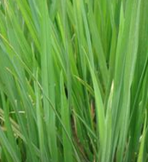
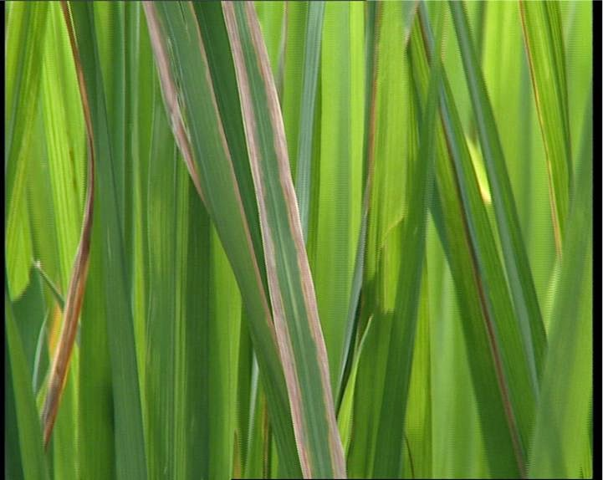
SOLUTION
The images are classified based on the stresses whether its biotic or abiotic stresses and further the biotic stresses are classified based on the diseases and healthy and unhealthy plants.
Healthy Paddy leaf
Plant Affected with Bacterial Plight
The disease identified above is bacterial plight which is identified from the water-soaked to yellowish stripes on leaf blades or starting at leaf tips with a wavy margin.

Slide 5
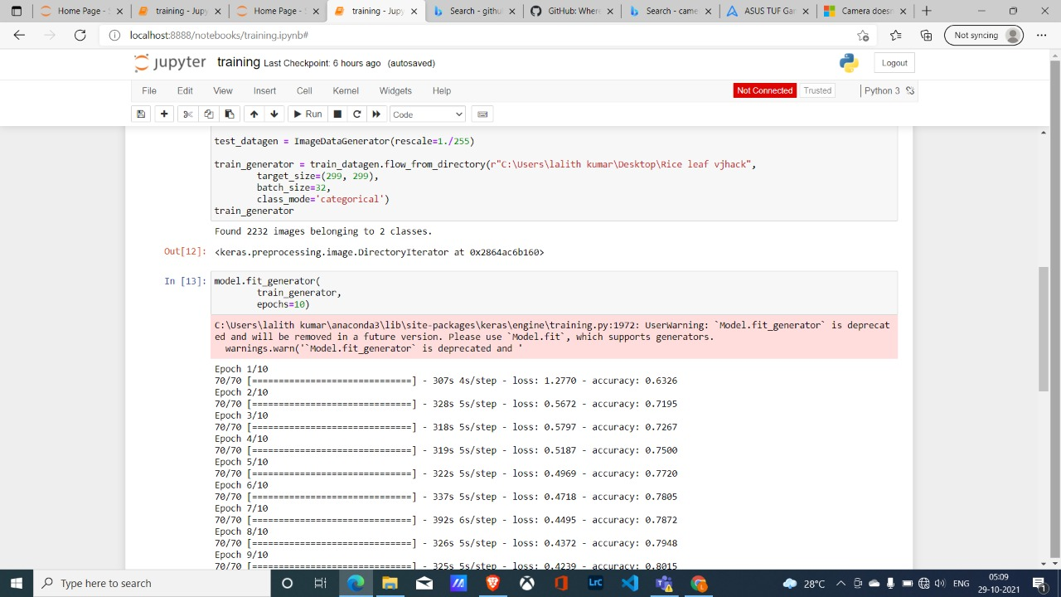
Further the classified images are trained based on different parameters with less epoch and more accuracy, Since less epoch means high accuracy and less runtime.
When an unknown image is input to the model it preprocesses the image and identify the disease and gives exact name of the disease and solution to the particular disease.

Slide 6
BLOCK DIAGRAM
Image Classification
Image Preprocessing
Data Acquisition
App Intergration
Training
Prediction
Testing

Slide 7
FLOW CHART
Start
Acquiring the required Datasets
Working with Tensor flow and Python
Training the created model in Jupyter
Integrating the model with app
End

Slide 8
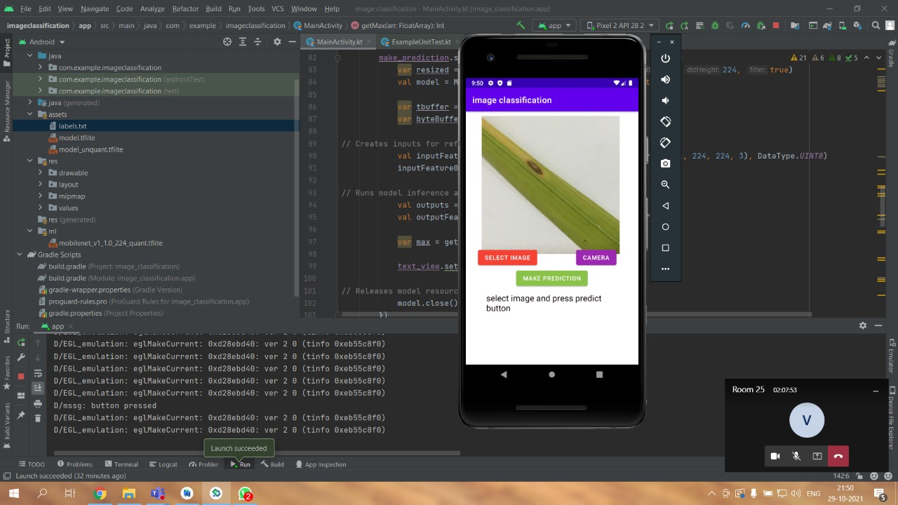
NOVELTY
Our Novelty stands in the place of our idea itself, the accuracy and less time consuming are our stand out features. We created a interface which is user friendly for our farmers.
Whenever a disease or any other stresses attacked the paddy our app will be the exact solution our farmers wanted.
The data set acquired or very specific and original, the images are very well preprocessed.
The created interface also have the required data’s for the farmers before they are planting the paddy.

Slide 9
LEVEL OF IMPLEMENTATION
From the Evaluation 1 to Evaluation 2 we have improved our training set with high accuracy.
We are in the process of developing our application.
Our Front End has the camera and default images to look for diseases before planting.
Our Back End is coming up with the Trained Data sets

Slide 10
LEVEL OF IMPLEMENTATION
We have Implemented floating and quantized model in our application.
And developed our own training and testing data finally, which is with high accuracy.
Created an app for finding the diseases by integrating our model with the app.

Slide 11
MEETING THE OBJECTIVES
We have identified different stresses and classified it through our research.
We also created the app with our training model to identify the stress identification.
Based on the real time images of field view and by comparing these with already preprocessed images we can easily find out the solution for the proposed problem.
Thus, We tried and completed the app as much as possible.

Slide 12
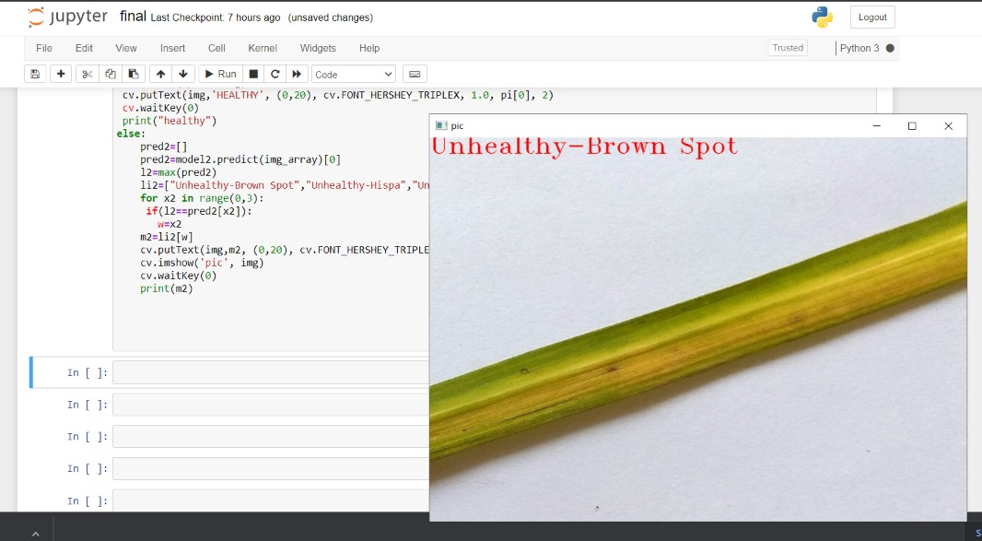
DEMO SHOWCASE
This is the test data result of paddy having brown spot

Slide 13
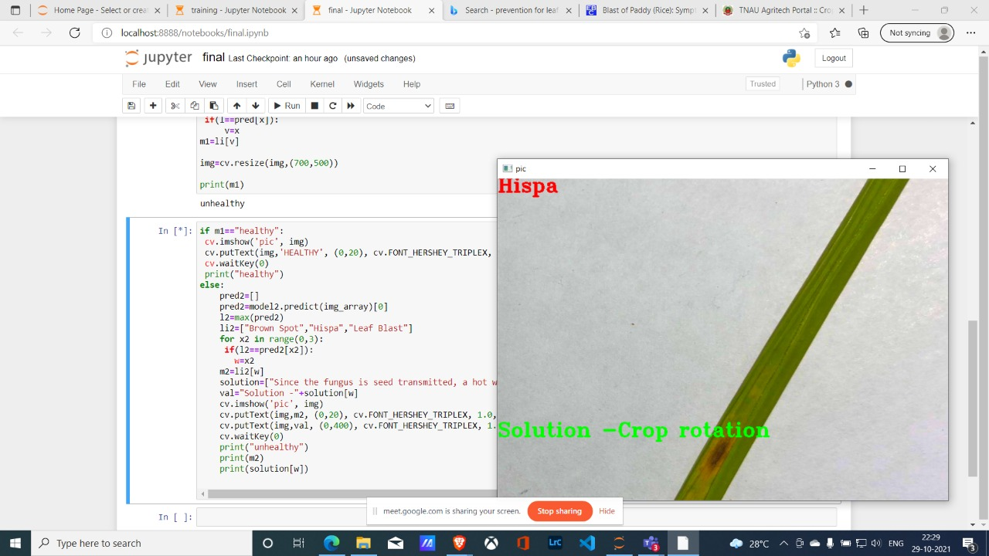
DEMO SHOWCASE
The final result comes with the solution of the identified disease in training

Slide 14
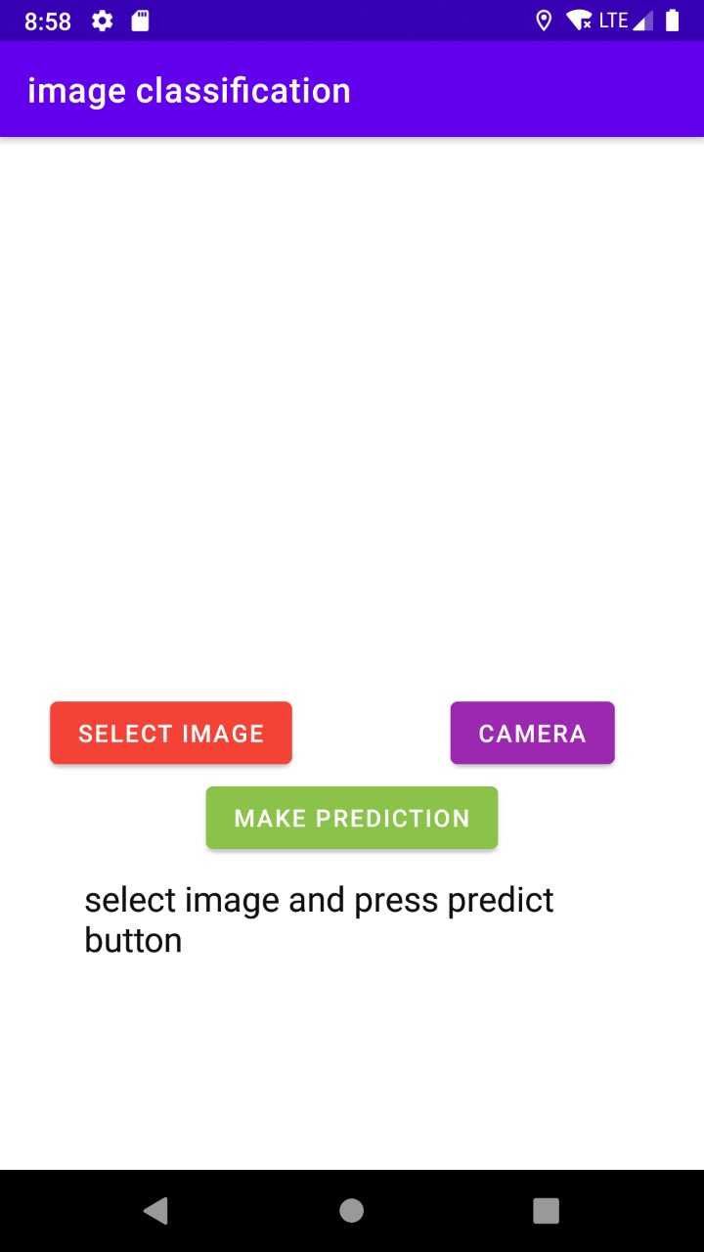
DEMO SHOWCASE
This is the home page of our app to make prediction

Slide 15
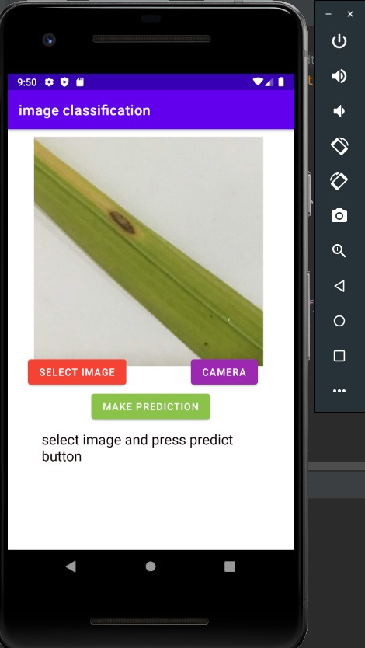
DEMO SHOWCASE
This is the prediction process which will take place in app

Slide 16
THANK YOU

